Slide 2
Internet Web Solutions
> Nowadays if you are not on the internet…
…YOU DO NOT EXIST

Slide 3
The Decalogue of Sustainability:
Practical Solutions for a Greener Workplace
Welcome to "The Decalogue of Sustainability: Practical Solutions for a Greener Workplace" workshop!
This comprehensive 10-step guide is designed to provide businesses with the necessary knowledge and skills to enhance their sustainability practices in the workplace and make a positive impact on the environment and society.
In this presentation, you will learn about the importance of sustainability in the workplace, as well as the best practices and strategies for achieving it.

Slide 4
Introduction
Sustainability has become an increasingly important issue in today's business world. As companies strive to reduce their environmental impact, promote social responsibility, and improve their bottom line, adopting sustainable practices in the workplace has become a crucial step towards achieving these goals.
This presentation will outline the decalogue of sustainability in the workplace, providing practical solutions for companies to reduce their environmental footprint, improve their social responsibility, and promote a more sustainable future for all.

Slide 5
1. Reduce energy consumption.
To reduce energy consumption in the workplace, consider using energy-efficient lighting systems such as LED lights, and devices. You can also promote good energy-saving habits and encourage employess to implement them. Some examples:
Turning off computers and other electronics when not in use.
Unplugging computers and electronic devices when charged or turned off.
Closing windows and doors when heating or cooling systems are on.
When it comes to heating and air conditioning systems, responsible use is key. The optimal approach is to minimize usage and select temperatures as closely aligned as possible with outdoor temperatures. However, it's important to establish guidelines that take into account your geographical location and local climate.
For instance, at IWS, which is situated in southern Spain, the winter season is brief while the summer season is prolonged. As a result, we endeavor to defer switching on the air conditioning system for as long as feasible, but we manage to operate more efficiently during the winter months.

Slide 6
2. Minimize waste.
Implementing a waste reduction program is crucial to minimize the amount of waste generated in the workplace.
Implement a water dispenser that provides both hot and cold water, and encourage your employees to bring their own reusable water bottles and mugs for hot beverages such as tea, coffee, and herbal infusions.
Consider providing a refrigerator and microwave to allow employees to bring their own food from home and avoid purchasing takeout meals, resulting in both environmental and economic benefits.
Implement a paperless policy. Use electronic documents and cloud-based storage systems to reduce the need for paper.
At IWS, we understand the challenges of implementing a fully paperless policy, but we recognize the importance of making incremental progress towards this goal.
Currently, we are exploring solutions to eliminate paper attendance lists, particularly during training sessions. One potential approach that we are evaluating involves the use of a tablet to collect electronic signatures during events.

Slide 7
3. Promote sustainable transportation.
With respect to work activities that occur outside of the office, such as multiplier events, training sessions, or team-building exercises, it is advisable to promote sustainable transportation options among your employees. Encourage them to use public transportation, walk, or bike whenever possible. In cases where these alternatives are not feasible, encourage carpooling.
To support these initiatives, consider allocating space for secure bicycle or scooter parking at your office location to facilitate sustainable commuting options.

Slide 8
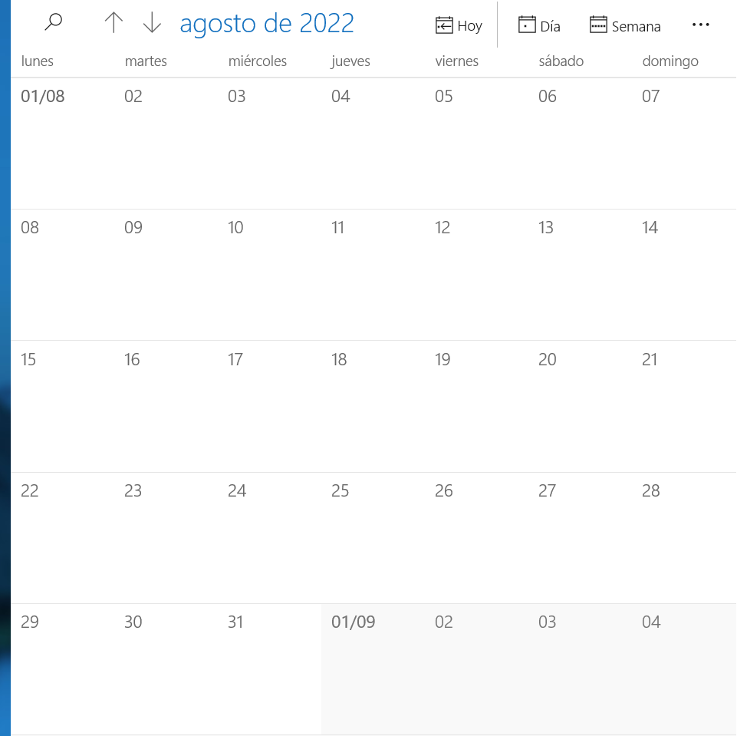
4. Offer flexible working arrangements.
Providing employees with flexible working arrangements such as telecommuting can reduce the need for commuting, and consequently, the carbon (and energy) footprint of the workplace.
IWS Good Practice 1:
During the summer season, when days are longer and temperatures are warmer, IWS has implemented measures to provide employees with more leisure time while also reducing the need for air conditioning in the workplace. One approach involves eliminating the traditional lunch break and slightly adjusting the start and end times of the workday.
IWS Good Practice 2:
Annually, the city of Malaga hosts a week-long fair in August, during a month that generally experiences low productivity and high temperatures. To accommodate this festive event and promote work-life balance, IWS opts to close the office for the week, and the team works remotely from home (before going out to celebrate together!).
Energy saved
Carbon footprint reduced
More work-life balance
Employees satisfaction guaranteed

Slide 9
5. Minimize business travel.
Minimize business travel by conducting meetings virtually instead of traveling, reducing carbon emissions associated with transportation.
In order to promote sustainable project management practices and minimize the carbon footprint associated with transnational projects, IWS and its partners have established a policy of conducting 50% of project meetings virtually. This approach significantly reduces the need for travel-related emissions, while still maintaining critical engagement with project partners.
Despite the advantages of technology, we recognize the importance of maintaining human contact with our partners. As a result, 50% of transnational project meetings are still conducted in person.
To further support sustainable travel, our employees have received training on sustainable travel practices.

Slide 10
6. Incorporate sustainable principles and practices into work procedures.
Project management
Integrate sustainability into project planning: consider sustainability from the beginning of the project and include specific sustainability goals in project planning.
Web development
Reduce file sizes: optimize images and files to reduce website size and improve loading speed. Use image compression tools and reduce the number of plugins and scripts.
Assess environmental impact: assess the environmental impact of the project and identify areas that require action to reduce environmental impact.
Use lightweight code: use lightweight, semantic code to reduce the amount of data that needs to be loaded from the website.
Choose Green Web Design Practices: Use sustainable web design practices that prioritize energy efficiency, minimalism, and sustainability. This includes using efficient coding practices and minimizing website bloat to reduce data transfer and server load.
Integrating sustainability principles and practices into all work processes is essential and requires continuous study and updating.
At IWS, we prioritize sustainability and proactively seek to minimize our environmental footprint by carefully analyzing all our activities.

Slide 11
7. Organize sustainable meetings/events.
When organizing events or meetings in the workplace, consider the environmental impact and strive to make them as sustainable as possible. This can include using reusable or compostable serving ware, providing vegetarian or vegan food options, and encouraging attendees to carpool or use public transportation.
The venue should be as eco-friendly as possible (low-consumption illumination, organic materials on items, based on renewable energies, local and ecologic alimentary products, etc.)
Make sure that no unnecessary printing is done. Agendas and meeting documents should be in digital format and sent by email, or they can be downloaded through a QR code.
The catering at meetings should come from responsible and local sources as much as possible. Food should not be individually wrapped, and the use of packaging should be minimized or avoided altogether. Small bottles of drinks should also be avoided.
Use reusable or compostable plates or think about options that do not require them. One idea is to offer finger food.

Slide 12
8. Incorporate a green wall/roof, or utilize plants in general to promote environmental sustainability.
Plants improve air quality by capturing and filtering pollutants, and reduce the urban heat island effect by cooling the surrounding air.
They provide insulation, which can help reduce energy consumption and save on heating and cooling costs. They can also create a more attractive and pleasant working environment for employees by adding natural elements and greenery to the workplace.
Moreover, studies show that having plants in the office can help reduce stress and improve employees' mental well-being.

Slide 13
9. Foster employee engagement.
Foster employee engagement in sustainability initiatives by encouraging employees to brainstorm ideas and share their input on sustainability practices in the workplace.
Listening to employee ideas and feedback can help identify new sustainability opportunities, build a sense of ownership and pride among employees, and create a culture of sustainability within the workplace. Organize regular meetings or forums where employees can share their ideas and collaborate on sustainability initiatives.
Motivational events or team building days can be organized with sustainability-related activities, such as eco-friendly workshops, volunteer environmental initiatives, or educational sessions on green practices.

Slide 14
10. Use sustainable marketing (and dissemination) strategies.
Use sustainable marketing strategies that prioritize online channels and reduce the use of printed materials.
Focus on online channels, such as social media, email marketing, and search engine optimization (SEO), to reach your audience. These channels are highly effective, provide greater reach, and require little or no paper-based materials.
If you must use printed marketing materials, opt for recycled paper and eco-friendly inks. This can significantly reduce the environmental impact of your marketing campaigns.
Use alternative forms of marketing collateral that require fewer printed materials. For example, use electronic brochures or digital marketing presentations instead of printed brochures.

Slide 15
Decalogue of Sustainability
Reduce energy consumption
Minimize business travel
Incorporate a green wall/roof, or utilize plants
Minimize waste
Promote sustainable transportation
Offer flexible working arrangements
Incorporate sustainable principles and practices into work procedures
Organize sustainable meetings/events
Foster employee engagement
Use sustainable marketing (and dissemination) strategies
Summing up
Congratulations!
This workshop has provided you with a comprehensive overview of the essential skills and strategies to adopt sustainable practices, reduce their environmental impact, and improve their social responsibility.
By reducing energy and water consumption, promoting sustainable transportation, using sustainable products and materials, and educating employees on sustainability practices, companies can make a significant contribution to building a more sustainable future for all. By working together towards this common goal, we can create a better world for future generations.

Slide 16
Internet Web Solutions www.internetwebsolutions.es
We
Believe and Create
in the Internet
Thank you for your attention

