Slide 2
Internet Web Solutions
> Nowadays if you are not on the internet…
…YOU DO NOT EXIST

Slide 3
Cybersecurity Essentials: A Decalogue of ICT and Cybersecurity Protocols for the Workplace
Welcome to "Cybersecurity Essentials: A Decalogue of ICT and Cybersecurity Protocols for the Workplace" workshop!
This comprehensive 10-step guide is designed to provide you with the necessary knowledge and skills to enhance your cybersecurity practices, protocols, and procedures in the workplace.
In this workshop, you will learn about the fundamental concepts of cybersecurity, such as threat analysis, risk management, and incident response. You will also be introduced to the latest cybersecurity technologies and tools used in the workplace, including firewalls, antivirus software, and intrusion detection systems.

Slide 4
Introduction
ICT and cybersecurity protocols are rules, procedures and guidelines designed to:
Ensure the proper functioning of information and communication technology systems;
Provide guidelines on how employees should use ICT systems, hardware, software, and data;
Protect an organization's networks, systems, and data from unauthorized access, theft, or damage.
ICT and cybersecurity protocols are essential in the workplace because they help to ensure the confidentiality, integrity, and availability of an organization's data and systems.
Without proper protocols in place, the organization's data and systems are vulnerable to cyber-attacks, data breaches, and other security threats!

Slide 5
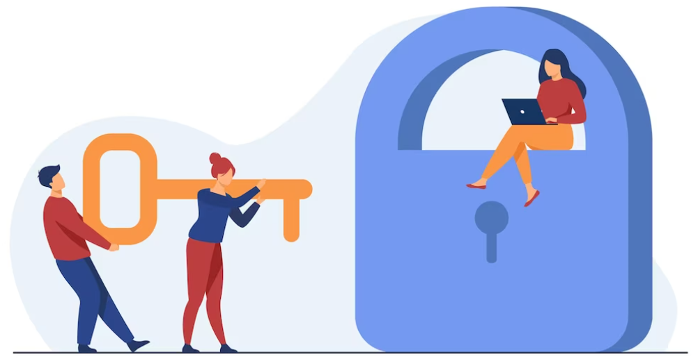
1. Use strong passwords and change them regularly.
Passwords are one of the most basic and important security measures.
Use strong passwords that are at least 12 characters long, with a mix of uppercase and lowercase letters, numbers, and symbols
Avoid using the same password for multiple accounts.
Change passwords regularly, at least every 90 days, and never share passwords with others.

Slide 6
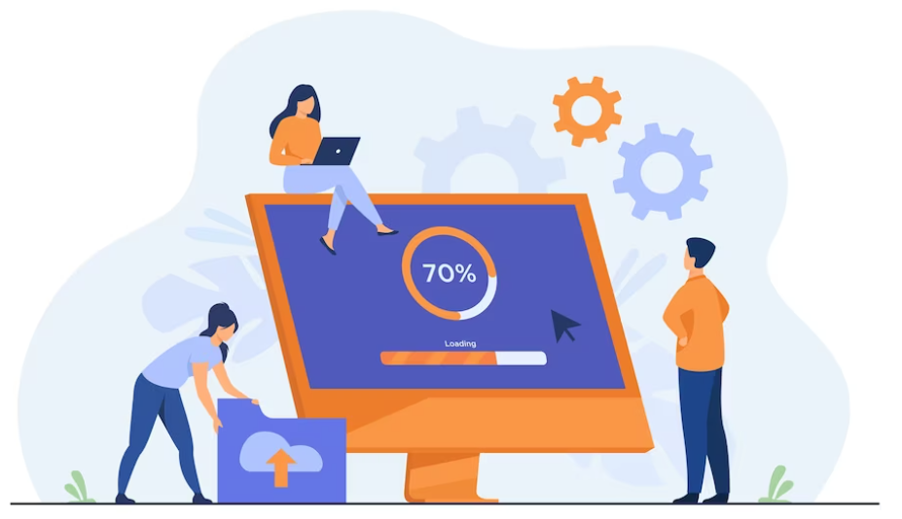
2. Keep software and operating systems up-to-date with the latest security patches.
Software and operating systems are regularly updated with security patches to address known vulnerabilities.
It's important to keep these up-to-date to protect against potential security threats.

Slide 7
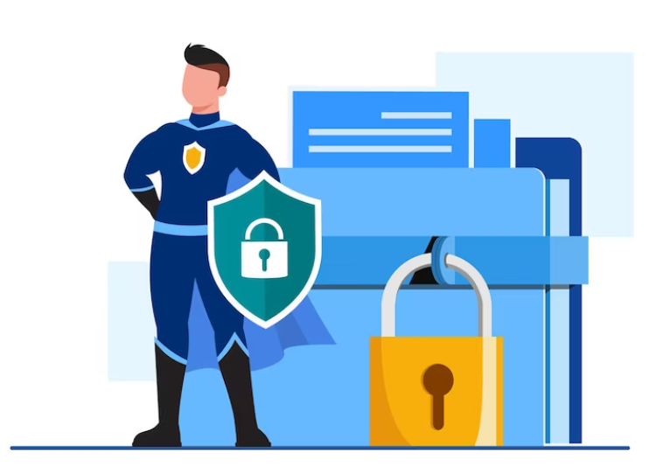
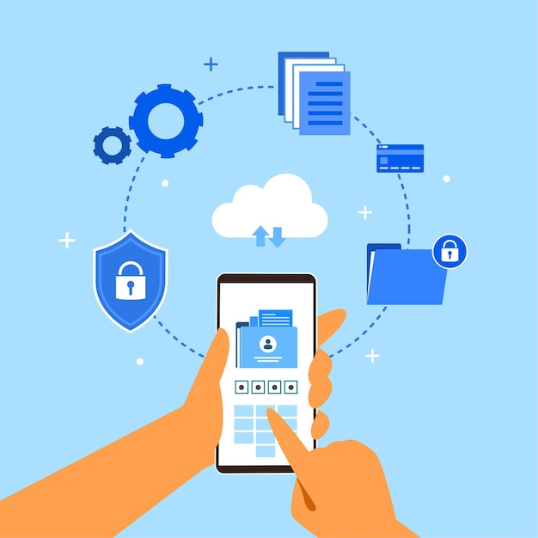
3. Encrypt sensitive data both in transit and at rest.
Encryption is the process of converting data into a code to prevent unauthorized access.
Sensitive data should be encrypted both in transit, when it is being transmitted over a network, and at rest, when it is stored on a device or server.

Slide 8
4. Use firewalls, antivirus software, endpoint encryption, and mobile device management software to protect endpoints, such as laptops, desktops, and mobile devices, from security threats.
Firewalls, intrusion detection and prevention systems, and virtual private networks are all important tools for protecting networks from unauthorized access.
Firewalls block unauthorized traffic.
Intrusion detection and prevention systems detect and prevent intrusions.
Virtual private networks create a secure connection between two networks.
Antivirus software can help to detect and remove malware from endpoints.
Endpoint encryption can help to protect the contents of endpoints from unauthorized access.
Mobile device management software can help to manage and secure mobile devices used in the workplace.
Always have the antivirus active and regularly run an antivirus and anti-malware scanner!

Slide 9
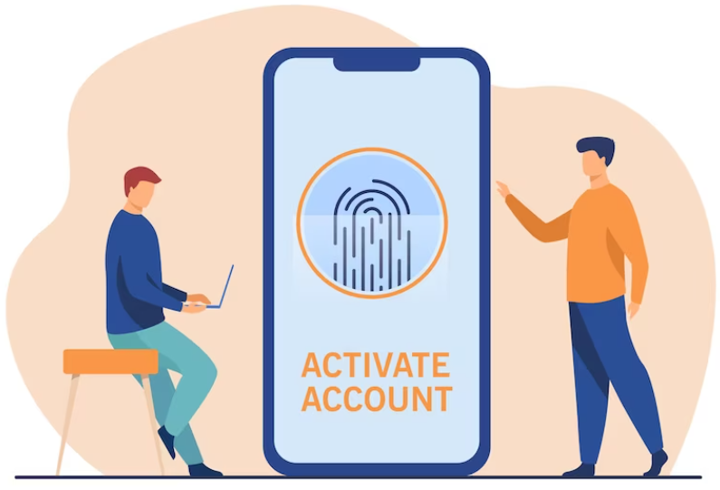
5. Implement access controls, including two-factor authentication and biometric authentication, to protect systems and data from unauthorized access.
Access controls are used to restrict access to systems and data to authorized users only.
Two-factor authentication requires users to provide two forms of identification, such as a password and a fingerprint scan.
Biometric authentication uses physical characteristics, such as fingerprints or facial recognition, to authenticate users.

Slide 10
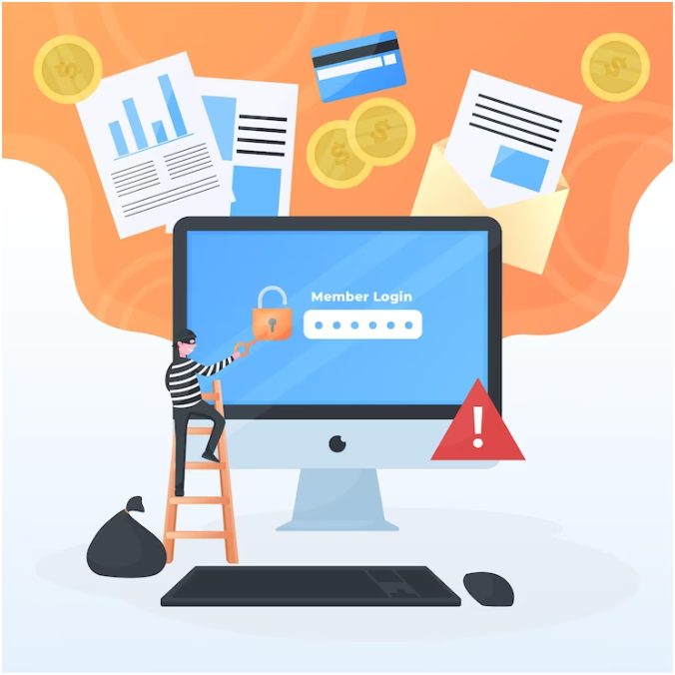
6. Monitor network activity for signs of intrusion or unauthorized access.
Network activity should be regularly monitored for signs of intrusion or unauthorized access.
This can include reviewing logs and analyzing network traffic to identify potential security threats.

Slide 11
7. Use email filtering, email encryption, and email authentication to protect email systems from spam, phishing attempts, and other security threats.
Email filtering can help to block spam and phishing attempts.
Email encryption can help to protect the contents of emails from unauthorized access.
Email authentication can help to ensure that emails are coming from a trusted source.
Never access links in e-mails from strangers, or download any attachment if you do not know the address from which it is sent!

Slide 12
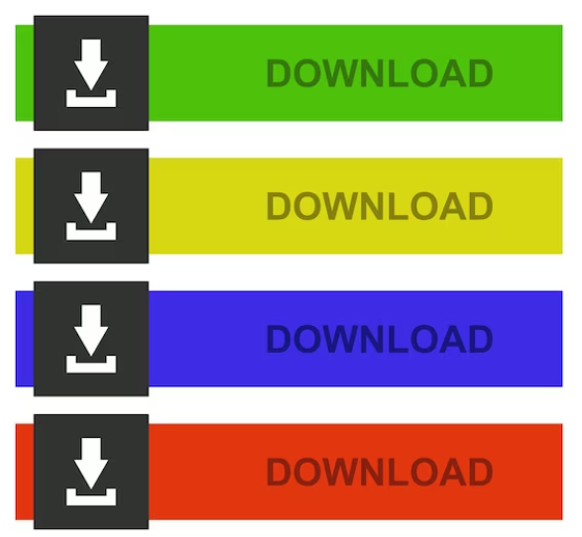
8. Exercise caution when downloading files or programs from the internet or email attachments.
To maintain secure downloading practices, it is crucial to:
Only download files, programs or software from trusted sources.
Verify them for malware before installing or opening.
Avoid downloading from untrustworthy sources that may use eye-catching "DOWNLOAD" buttons.
Download software solely from its official website.

Slide 13
9. Regularly back up data and store it in a secure location.
Regularly backing up data is important to prevent data loss in case of security incidents, hardware failure or accidental deletion.
Backups should be automated, and data should be stored in a secure location, either off-site or in a cloud-based backup service that is protected by access controls and encryption.

Slide 14
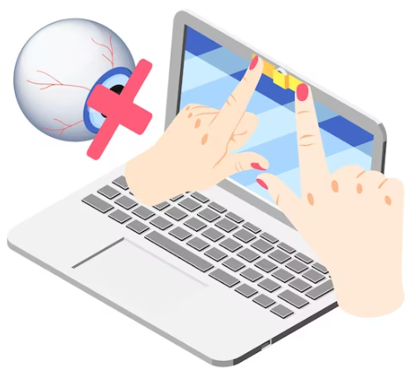
10. Exercise utmost caution and discretion when navigating the digital landscape.
To guarantee the highest level of security and safeguard your confidential data, it is essential to exercise the utmost caution and discretion when navigating the digital landscape.
To this end, it is recommended to adopt basic security practices, such as refraining from entering any personal or sensitive information on sites that lack SSL (HTTPS) encryption or covering the camera on devices such as laptops or desktops to prevent any unauthorized access.

Slide 15
ICT and Cybersec protocols
Use strong passwords
Implement access controls
Exercise caution when downloading
Keep software and operating systems up-to-date
Encrypt sensitive data
Use firewalls and antivirus software
Monitor network activity
Use email filtering, encryption, and authentication
Regularly back up data
Exercise caution and discretion when navigating the digital landscape
Summing up
Congratulations!
You have learned valuable strategies, tools, and tips to help you improve your ICT and cybersecurity protocols in the workplace.
By following these guidelines, organizations can significantly reduce the risk of cyberattacks and protect sensitive data and systems in the workplace.
Remember that cybersecurity is a continuous process and it's important to keep reviewing and updating your policies and procedures as needed.

Slide 16
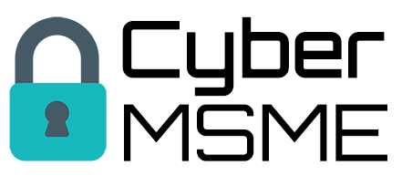
Additional resources
Related training courses from our projects
Cyber MSME training courses – https://www.cybermsme.eu/training.php
Swift SME training courses – https://www.swiftsme.eu/training.php

Slide 17
Internet Web Solutions www.internetwebsolutions.es
We
Believe and Create
in the Internet
Thank you for your attention

