Slide 2
Internet Web Solutions
> Nowadays if you are not on the internet…
…YOU DO NOT EXIST

Slide 3
The Decalogue of Digital Communication:
A Comprehensive Guide to Successful Collaboration in the Digital Workplace
Welcome to "The Decalogue of Digital Communication:
A Comprehensive Guide to Successful Collaboration in the Digital Workplace" workshop!
This comprehensive 10-step guide is designed to provide you with the necessary knowledge and skills to enhance your digital communication and collaboration abilities in the workplace.
In this workshop, you will learn about the importance of effective digital communication and collaboration in the workplace, as well as the best practices and strategies for achieving it.

Slide 4
Introduction
In today's fast-paced and globalized work environment, effective digital communication and collaboration have become increasingly critical for success. As more companies rely on digital tools and technologies for communication and collaboration, it's essential to have clear guidelines and best practices to ensure productive and efficient teamwork.
This Decalogue presents ten guidelines that can help individuals and teams communicate and collaborate effectively in the digital workplace.
By following these guidelines, you can enhance your communication and collaboration skills, build stronger relationships with your colleagues, and achieve better outcomes in your work.

Slide 5
1. Choose the right digital communication tools.
Select the appropriate digital communication tools that cater to your specific communication needs, based on criteria such as the importance or formality of the information to be communicated.
Email is a formal mode of communication that allows you to structure your message in a clear and organized way, and it provides a written record of the communication, which can be useful for future reference.
When communicating less formal or time-sensitive information, using an instant messaging tool like Slack or Skype can be more appropriate.
For more interactive communication, video conferencing tools like Zoom or Skype can be used. Video conferencing is ideal for remote or virtual teams who need to collaborate and communicate face-to-face in real-time. It can be used to conduct team meetings, presentations, or interviews.

Slide 6
2. Use correct, clear and concise language.
Use correct, clear and concise language when communicating digitally.
Use proper grammar, spelling, and punctuation.
Avoid using complex vocabulary or long sentences, as they can cause confusion and misinterpretation.
Use simple language to convey your message effectively.
Use bullet points and numbered lists to organize information.

Slide 7
3. Use a professional tone.
Maintain a respectful and professional tone when communicating digitally, and practice digital netiquette when communicating in the workplace.
Avoid using informal language, slang, or abbreviations that are not commonly used in the workplace.
Tone can be difficult to convey via text. Be careful not to overuse emoticons, as they can come across as unprofessional.
Avoid sarcasm or irony that can be misinterpreted in a digital context.
Avoid using all caps or excessive exclamation marks, as this can be interpreted as shouting.
Use appropriate salutations and sign-offs in your emails.

Slide 8
4. Define deadlines and seek clarification.
When working collaboratively, it's important to clarify expectations and deadlines. This helps to avoid misunderstandings and delays.
Clearly communicate what needs to be accomplished, by whom, and when.
If you are unsure about something, seek clarification.
Don't assume that everyone knows what you are talking about.
Ask questions and seek feedback to ensure effective communication.

Slide 9
5. Be responsive.
Respond promptly to digital communication, particularly in group settings.
Do not delay in acknowledging receipt of messages or responding to them until you have received all the necessary information or completed the work that has been requested of you. It is important to promptly acknowledge receipt of communication and respond as soon as possible. This helps to maintain effective communication and avoid unnecessary delays.

Slide 10
6. Be respectful and aware of the company’s policies.
When communicating digitally, it's important to be respectful and aware of others' privacy and company policies.
Always seek permission before sharing personal or confidential information.
Respect other people's privacy and avoid sharing any sensitive information without their consent.
Be aware and adhere to your company's policies and regulations regarding digital communication.This includes policies related to data protection, cybersecurity, and the appropriate use of digital communication tools.

Slide 11
7. Share information effectively.
Share information effectively using digital communication tools.
Use project management tools to share information about tasks and deadlines. This helps to ensure everyone is on the same page.
Use video conferencing and screen sharing tools when possible, to facilitate real-time collaboration and communication.

Slide 12
8. Use emails effectively.
Using a clear and professional subject line in emails is important as it helps the recipient to prioritize and organize their emails, leading to more efficient communication.
Sending large attachments or files via email can slow down email systems and create clutter in inboxes. It is recommended to use cloud storage services like Google Drive or Dropbox to share files with colleagues.
Using cc and bcc fields appropriately when sending emails to multiple recipients is important. Use cc when others need to be informed or take action, and use bcc when you don't want to reveal email addresses to other recipients.

Slide 13
9. Be precise in naming files.
When naming files, it is important to be precise to make it easier to locate and organize files.
You can establish a standard naming convention for all digital files and documents. Using a format like "projectname_filedescription_language" can help ensure that files are named consistently and meaningfully.
It can also be helpful to use dates to differentiate versions of a file. For example, naming a file "projectname_filedescription_01012020" would indicate that the file was last updated on January 1, 2020.
It is important to avoid using special characters, accents, and spaces, which may not be recognizable by some computer systems. Instead, it is recommended to use underscores (_) to separate words in a file name.

Slide 14
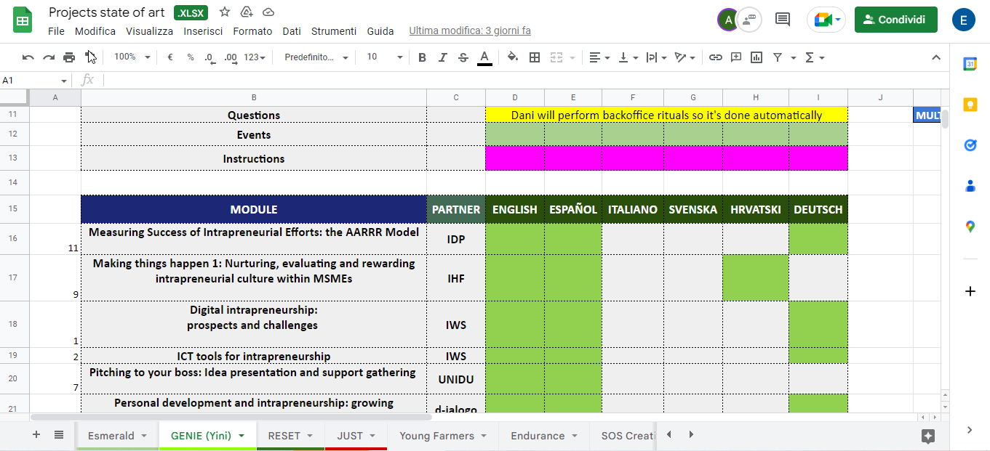
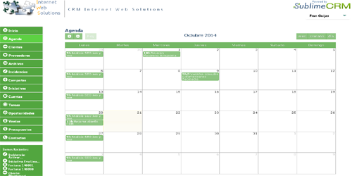
10. Use shared documents to monitor the status of tasks.
Using shared documents can be a great way to monitor the status of tasks and keep everyone on the same page. One way to make it even easier to track progress is to use standard colours to indicate the status of different tasks.
It is important to be creative and use the tools at your disposal to optimize time and communications within teams and the company. This can include using collaboration software, project management tools, and other technologies to streamline workflows and facilitate communication.

Slide 15
Digital Communication and Collaboration
Choose the right digital communication tools
Be responsive
Use emails effectively
Use correct, clear and concise language
Use a professional tone
Define deadlines and seek clarification
Be respectful and aware of the company’s policies
Share information effectively
Be precise in naming files
Use shared documents to monitor the status of tasks
Summing up
Congratulations!
This workshop has provided you with a comprehensive overview of the essential skills and strategies for effective digital communication and collaboration in the workplace.
By following these guidelines, you can improve communication and collaboration in the workplace, build stronger relationships with your colleagues, become a more effective and productive member of your team and contribute to the overall success of your organization.

Slide 16
Additional resources
Related training courses from our projects
Swift SME training courses – https://www.swiftsme.eu/ficha.php?id_ficha=14
Esmerald training courses - https://esmerald.eu/ficha.php?lang=EN&id_ficha=12

Slide 17
Internet Web Solutions www.internetwebsolutions.es
We
Believe and Create
in the Internet
Thank you for your attention

